Slide 1

lesson 11
    Operating System Basics

Slide 2
This lesson includes the following sections:
    The User Interface
    Running Programs
    Managing Files
    Managing Hardware
    Utility Software

Slide 3
The User Interface
Graphical User Interfaces (GUIs)
GUI Tools
Applications and the Interface
Menus
Dialog Boxes
Command-Line Interfaces

Slide 4
  The User Interface
  - Graphical User Interfaces (GUIs)
Most modern operating systems, like Windows and the Macintosh OS, provide a graphical user interface (GUI).
A GUI lets you control the system by using a mouse to click graphical objects on screen.
A GUI is based on the desktop metaphor. Graphical objects appear on a background (the desktop), representing resources you can use.

Slide 5
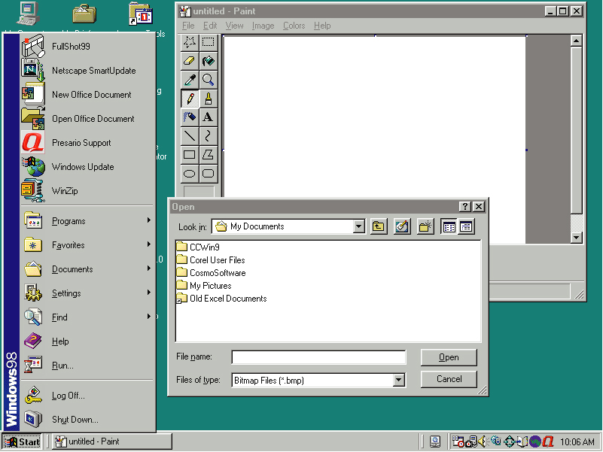
Icons
Program
running in
a window
Desktop
Window control buttons
Start menu
Start button
Dialog box
Taskbar

Slide 6
The User Interface - GUI Tools
Icons are pictures that represent computer resources, such as printers, documents, and programs.
You double-click an icon to choose (activate) it, for instance, to launch a program.
The Windows operating system offers two unique tools, called the taskbar and Start button. These help you run and manage programs.

Slide 7
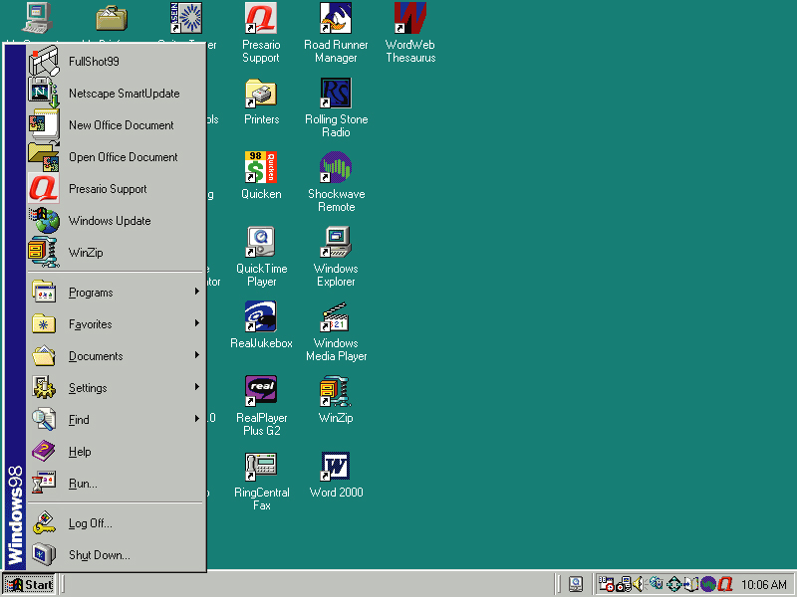
The Windows start
button can be used
to launch programs.
Or, icons can be
double-clicked to
launch programs.

Slide 8
  The User Interface –
  Applications and the Interface
Applications designed to run under one operating system use similar interface elements.
Under an OS such as Windows, you see a familiar interface no matter what programs you use.
In a GUI, each program opens and runs in a separate window—a frame that presents the program and its documents.
In a GUI, you can run multiple programs at once, each in a separate window. The application in use is said to be the active window.

Slide 9
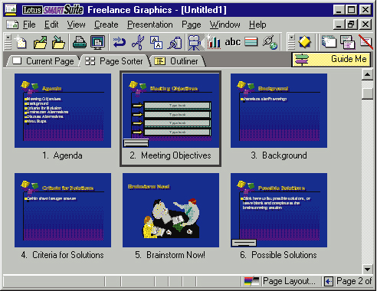
Titlebar
Menubar
Scroll arrow
Click the Minimize button to reduce
the program to a button on the taskbar.
Click the Maximize button to restore
the window to its previous size.
Click the Close button to close
the window altogether.
Toolbar
Scroll box
Scroll bar

Slide 10
The User Interface - Menus
GUI-based programs let you issue commands by choosing them from menus.
A menu groups related commands. For example, the File menu's commands let you open, save, and print document files.
Menus let you avoid memorizing and typing command names.
In programs designed for the same GUI, menus and commands are similar from one program to another.

Slide 11
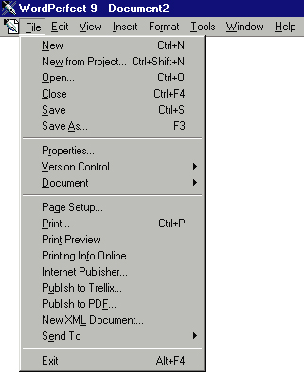

Slide 12
The User Interface - Dialog Boxes
A dialog box is a special window that appears when a program or the OS needs more information before completing a task.
Dialog boxes are so named because they conduct a "dialog" with the user, asking the user to provide more information or make choices.

Slide 13
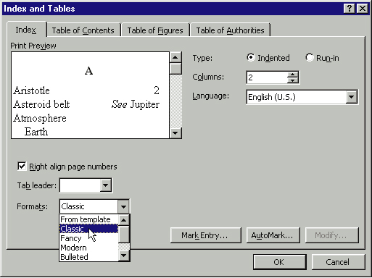

Slide 14
.
The User Interface - Command-Line Interfaces
Some older operating systems, such as DOS and UNIX, use command-line interfaces.
In a command-line interface, you type commands at a prompt.
Under command-line interfaces, individual applications do not need to look or function the same way, so different programs can look very different

Slide 15
The DOS Prompt is not seen much these days!

Slide 16
Running Programs
Basic Services
Sharing Information
Multitasking

Slide 17
Running Programs - Basic Services
The operating system manages all the other programs that run on the PC.
The operating system provides services to programs and the user, including file management, memory management, and printing
To provide services to programs, the OS makes system calls—requesting other hardware and software resources to perform tasks.

Slide 18
Running Programs - Sharing Information
Some operating systems, such as Windows, enable programs to share information.
You can create data in one program and use it again in other programs without re-creating it.
Windows provides the Clipboard, a special area that stores data cut or copied from one document, so you can re-use it elsewhere.

Slide 19
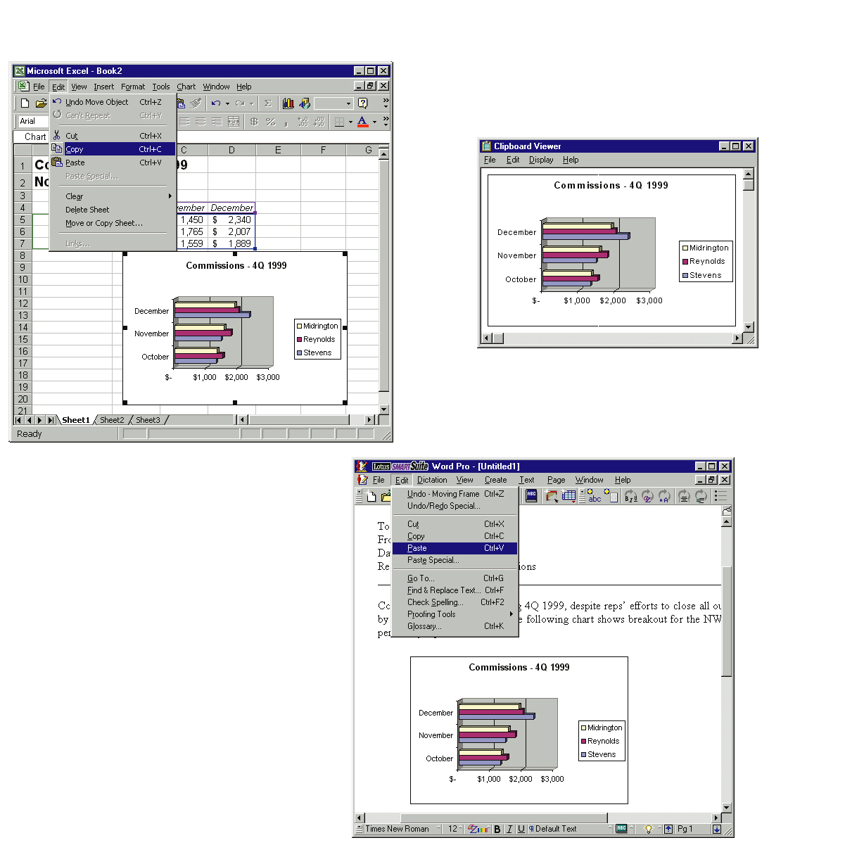

2
1
1
Information is clipped
from one application (Excel)
2
Using the clipboard Viewer to
examine the information
3
3
Pasting the information
into another application (WordPro)

Slide 20
Running Programs - Multitasking
Multitasking is the capability of running multiple processes simultaneously.
A multitasking OS lets you run multiple programs at the same time.
Through multitasking, you can do several chores at one time, such as printing a document while downloading a file from the Internet.
There are two types of multitasking: cooperative and preemptive.

Slide 21
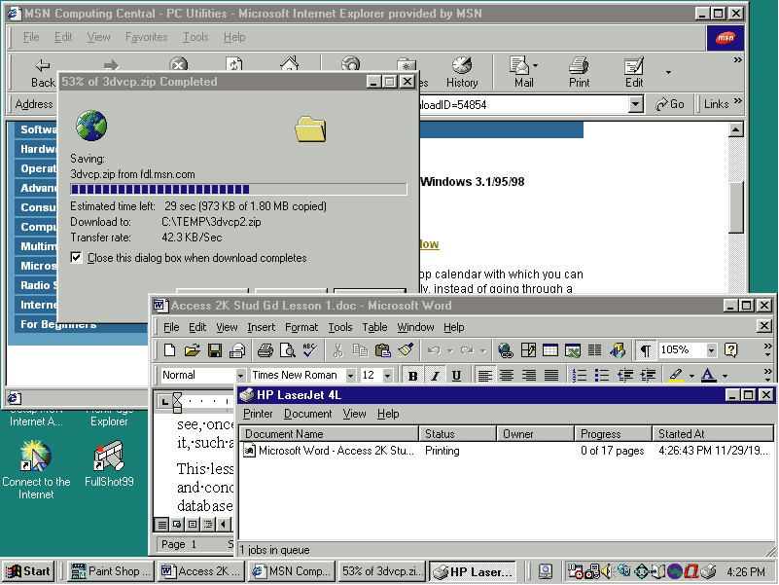

Slide 22
Managing Files
The operating system keeps track of all the files on each disk.
Users can make file management easier by creating a hierarchical file system that includes folders and subfolders arranged in a logical order.

Slide 23
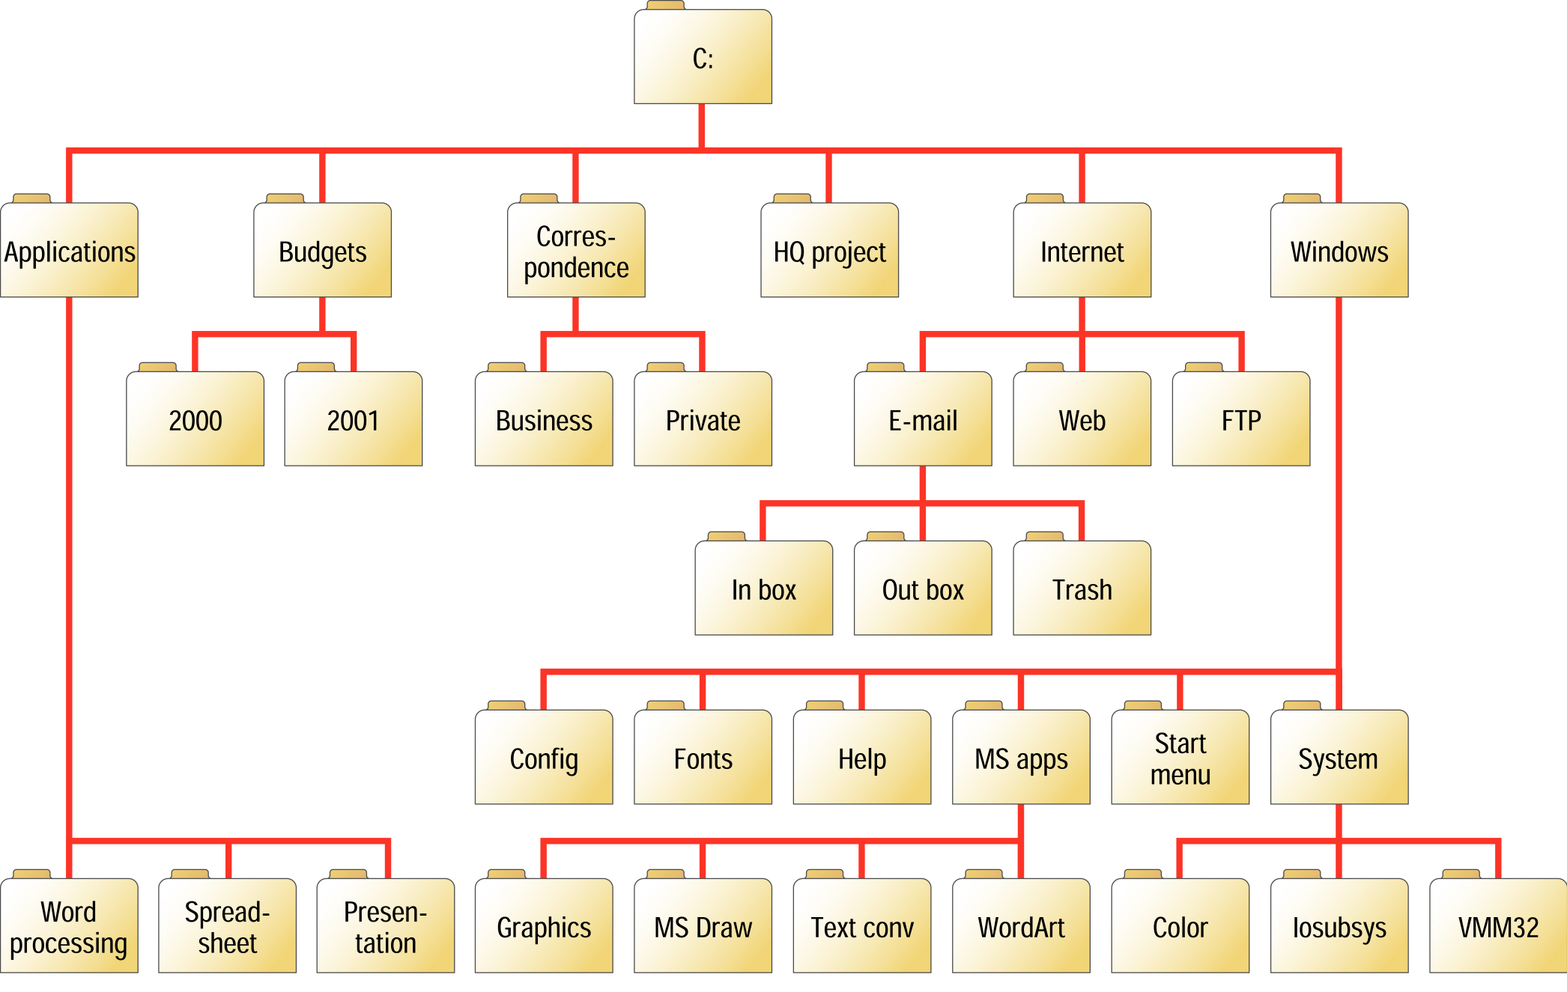

Slide 24
Managing Hardware
The OS uses interrupt requests (IRQs) to maintain organized communication with the CPU and other pieces of hardware.
Each hardware device is controlled by a piece of software, called a driver, which allows the OS to activate and use the device.
The operating system provides the software necessary to link computers and form a network.

Slide 25
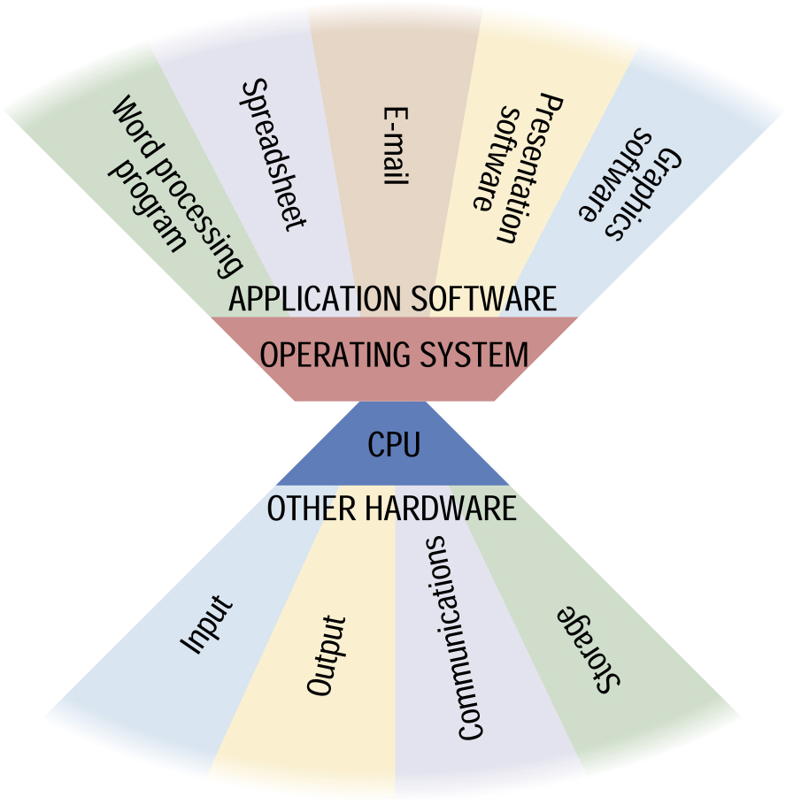

Slide 26
Utility Software
A utility is a program that performs a task that is not typically handled by the operating system.
Some utilities enhance the operating system's functionality.
Some of the major categories of utilities include:
  File defragmentation
  Data compression
  Backup
  Antivirus
  Screen savers

Slide 27
lesson 11 review
Name four components found in most graphical user interfaces.
Describe the operating system’s role in running software programs.
Explain how the OS enables users to manage files.
List three hardware management tasks performed by an OS.
Name five types of utility software.

